Slide 1
© HiTech Solutions & Services Pvt. Ltd

Slide 2
Company Profile
HiTech Solutions & Services is one of the premier business solution providers in Nepal serving its valued clients since last 17 years. We have our support and marketing offices scattered not only in Kathmandu but almost all over Nepal. For Today’s demanding environment of dynamic business, we are committed to deliver quality products, services and solutions that enrich business and the lives around them. Below are few of our products which have EXCELLED in Nepalese market.
© HiTech Solutions & Services Pvt. Ltd

Slide 3
Goals and Objectives
Empowering people, creating smile
Providing world class technology solutions in a very cost effective way
Conduct business in a way that mutually benefits both clients and employees
Making people happy through technology and service
Making clients aware of new technology
Developing pool of highly skilled IT professional
Creating new way of employment and strengthen country through IT
© HiTech Solutions & Services Pvt. Ltd

Slide 4
Our Strength
15+ Channel
Partner
© HiTech Solutions & Services Pvt. Ltd

Slide 5
Our Solutions & Services
Application Software Development
Customized Software Development
ERP Solution
Mobile Apps Development
E-Commerce Development
Web Application Development
System Analysis, Designing, Coding and Implementation
System Integration and Testing
© HiTech Solutions & Services Pvt. Ltd

Slide 6
Our Network
© HiTech Solutions & Services Pvt. Ltd

Slide 7
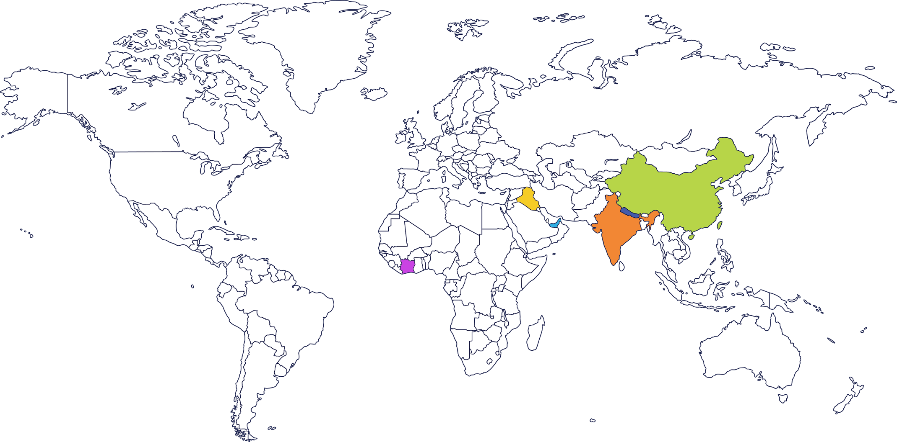
Our Worldwide Network
NEPAL
INDIA
CHINA
IRAQ
UAE
IVORY COAST
© HiTech Solutions & Services Pvt. Ltd

Slide 8
Our Channel Partners
HiTech Solution – Itahari / Biratnagar
HiTech Solutions & Services - Birgunj
CSE Enterprises – Butwal
HiTech Solutions & Services - Bhairahawa
Professional Trading House - Pokhara
Rara Computer Education - Nepalgunj
Amar & Company - Janakpur
CSE Trade Link - Narayanghat
Subesh Tamrakar - Banepa
Family Computer - Siraha
Creative Concern - Mahendranagar
Bed Dhakal – Dhangadhi
Ravi Ranjan – Bardibas
Deepu Ji - Dang
CHANNEL
PARTNERS
© HiTech Solutions & Services Pvt. Ltd

Slide 9
Our Products
© HiTech Solutions & Services Pvt. Ltd

Slide 10
Our Distributor
Hospitality Software
Real-Estate Developer And
Construction Industry
Software
Sales Force Automation Mobile App
© HiTech Solutions & Services Pvt. Ltd

Slide 11
About Avocare
Avocare - HiTech Hospital Management Solution is a comprehensive, user friendly, Flexible, Multi Module, Web Based Software designed to manage all type of hospital either it is multi specially hospital, government hospital of clinics, operations. Avocare tracks the complete journey of every patient from patient profile, OUT and IN patient, Billing, Nursing station, Doctor consultancy, Digital Medical records, OT, Lab, Radiology, Imaging, Pharmacy, Kitchen, Laundry, Diet Planning, Ambulance and discharge. It’s a tool which keeps you up to date for all your required day to day hospital reports, Analysis and Management reports with Single Entry. This application is available for Doctor, Patient, Nurse, Cashiers, Management Team, Pharmacist, Lab Technicians, Finance Team, Maintenance Team, HR and all departments.
© HiTech Solutions & Services Pvt. Ltd

Slide 12
Advantages of Computerization of Hospital
Achieve good quality ratings
A good hospital management system stands out your medical center,
nursing home, or hospital distinctly from competitors.
Better revenue management
It offers fast and accurate transactional and management reports that give
an instant feel of how the business is doing.
Avoid errors and track every single detail
Installing an automated management system removes the chance of error completely tracking a minute detail of room occupancy, staff availability,
and operational information is available at the fingertips.
Improved clinical decision-making
A good quality management system makes sure that operational and
clinical decision-making process is fast, accurate, and efficient
Establish your hospital as technically advanced
It is possible to maintain connectivity with patients and peripheral systems
if the operations are managed using automated systems.
© HiTech Solutions & Services Pvt. Ltd

Slide 13
WHY AVOCARE HMS
© HiTech Solutions & Services Pvt. Ltd

Slide 14
WHY AVOCARE HMS?
Paper Less Work
Reduce Redundancy
Dedicated Support Team with Customization
Mobile App for doctor, patient and management team
Get any information on one click
Access to Information ON DEMAND
Integration with 3rd Party Software
© HiTech Solutions & Services Pvt. Ltd

Slide 15
Avocare’s Offering
Solution is customizable while standardizing the process.
Adaptive work flows to meet Corporate needs.
User defined forms and security (fine grained).
User friendly and Interactive Rich UI(Non-IT users)
Secured, Robust & Comprehensive solution.
Bi-Directional integration with devices
Web based application – Can be accessed globally
© HiTech Solutions & Services Pvt. Ltd

Slide 16
Avocare – HHMS Clients
Kailash Cancer Hospital, Vadodara, India
Premdas Jhulelal Hospital, Vadodara, India
Imam Zain Alabedin Hospital Karbala, Iraq
Alkafeel hospital, Karbala, Iraq
CMS Abidjan, Abidjan, Ivory Coast
Poly Clinic Central Abobo Abidjan, Abidjan, Ivory Coast
© HiTech Solutions & Services Pvt. Ltd

Slide 17
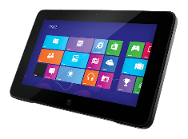
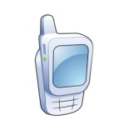
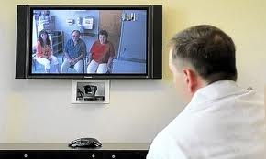
Avocare Solution Landscape
Kiosk
Clinical
Research
Centre
Tablet
Public
Report
Mobile
Intranet
Physician
Regulator
Corporate
Centre
Management
Staff
Management
Laptop
Query
Server
Supplier / Company
Staff
Intranet
Desktop
Hospital
Diagnostic
Centre
Clinic
Pharmacy
Telemedicine
© HiTech Solutions & Services Pvt. Ltd

Slide 18
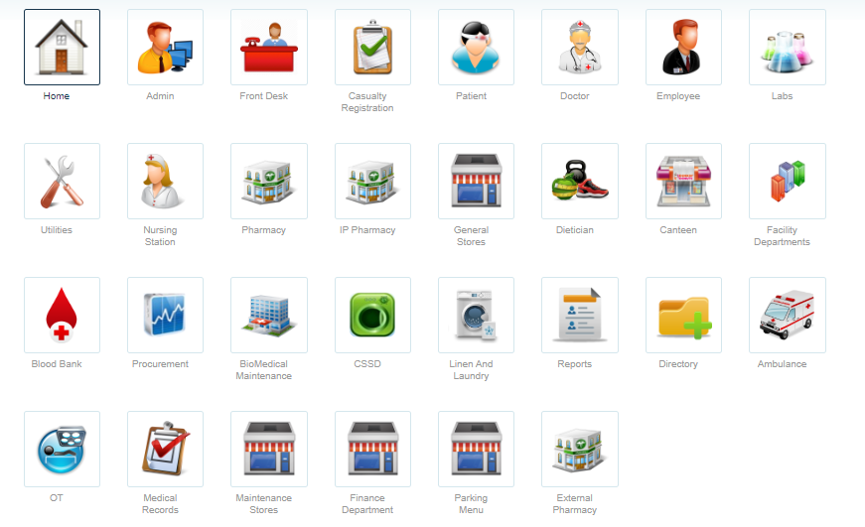
HMS MODULES
© HiTech Solutions & Services Pvt. Ltd

Slide 19
HMS Ecosystem – Functional Model
.NET Platform (C#)
MS SQL Database
Silverlight
Jquery
Telerik UI
AVOCARE
Pharmacy
Reports
Doctors
Front Desk
General Store
Blood Bank
Patient Records Mgmt.
Nursing Station
Ambulance
MIS Reports
OP/IP
Lab/
Radiology Billing
Lab / RadTest
Canteen &
Parking
© HiTech Solutions & Services Pvt. Ltd

Slide 20
Admin functionality
© HiTech Solutions & Services Pvt. Ltd

Slide 21
Admin Functionality
The application setup module deals with security. This module defines access control to the information available in the application. All user groups have spate access rights for modules.
Hospital Setup
Users roles and right
Cashier Management
Security
Pharmacy Management
Employee Management
Lab / Radiology Test
And many more setup options
© HiTech Solutions & Services Pvt. Ltd

Slide 22
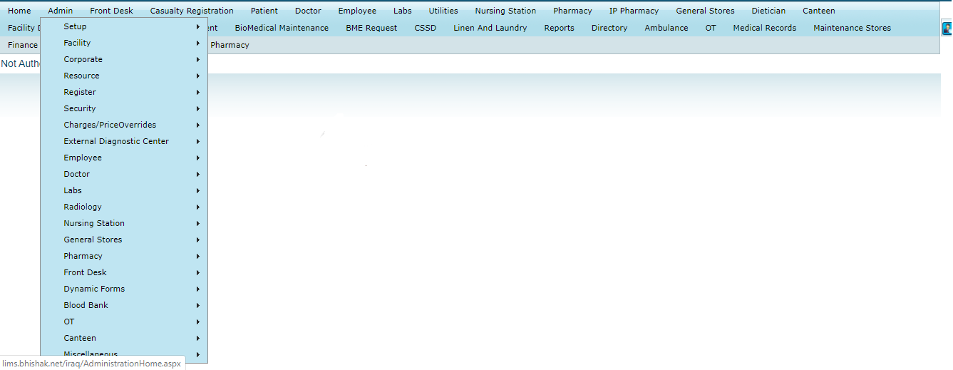
Application Setup
© HiTech Solutions & Services Pvt. Ltd

Slide 23
Front desk
© HiTech Solutions & Services Pvt. Ltd

Slide 24
Front Desk - Overview
OP Registration and Billing
IP Admissions Billing ,Floor Selection and Room Transfers
Patient Appointment Scheduling
Causality / Emergency Patient Registration
Laboratory / Radiology Patient Registration
© HiTech Solutions & Services Pvt. Ltd

Slide 25
Patient Appointment Scheduling
Capture Patient’s Demographic details with photograph
Enable Normal Registration/Bulk Registration
Capture details on Patient dependents
User definable parameters for Registration fields (Mandatory/Prompt if Missing/Track updates)
Unique patient identifier
Create Doctors Duty Roster, Changes to duty roster, Block Appointments
Appointment Scheduling, Rescheduling, Cancellation, Wait Lists, Walk-in appointments
View all patients’ previous visitations to the hospital.
View Available Appointments, Booked Appointments, Visited patients list, No-show patients list
Telephonic Appointments
© HiTech Solutions & Services Pvt. Ltd

Slide 26
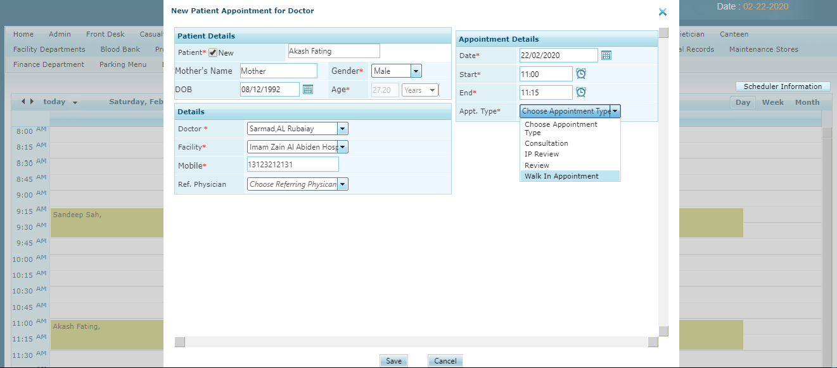
Patient Appointment Scheduling
© HiTech Solutions & Services Pvt. Ltd

Slide 27
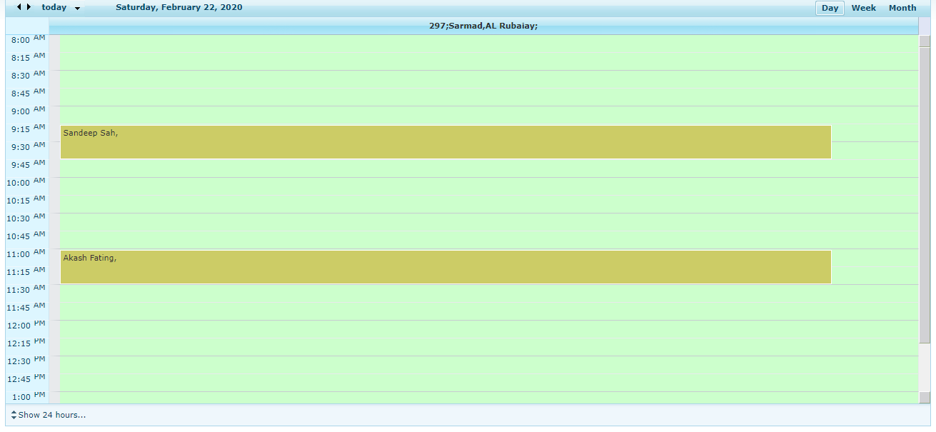
Patient Appointment Scheduling
© HiTech Solutions & Services Pvt. Ltd

Slide 28
Op patient registration
© HiTech Solutions & Services Pvt. Ltd

Slide 29
OP Registration
User can add new and existing patient
RFID Card can access
On selecting existing patient name last visit and doctor name will appear
Discount making , corporate selection available
Patient Review available
Free bill can make
Procedure can add
IP review available
Photo capture available
After saving auto receipt generate with Barcode and Doctor Patient number
Once saved bill able to edit info (only admin or special users)
© HiTech Solutions & Services Pvt. Ltd

Slide 30
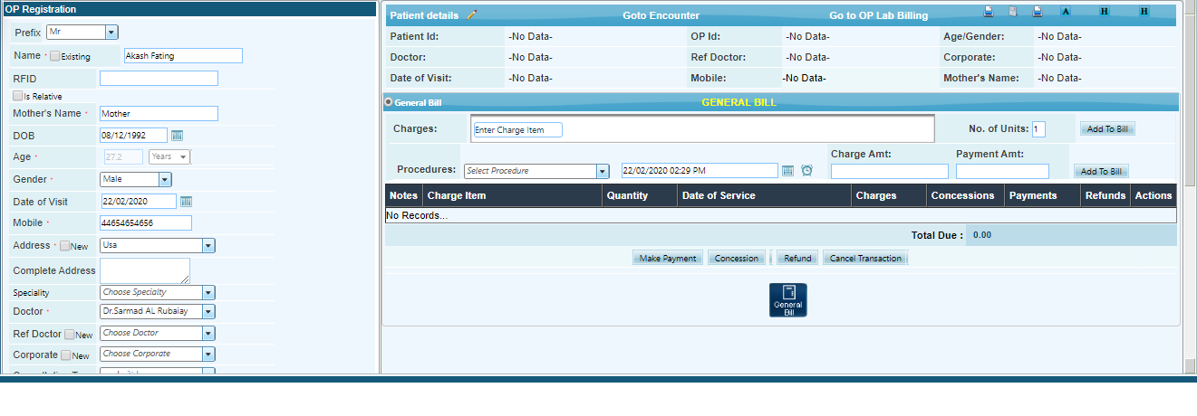
OP Registration Screen
© HiTech Solutions & Services Pvt. Ltd

Slide 31
IP patient BILLING
© HiTech Solutions & Services Pvt. Ltd

Slide 32
Features
Patient cost estimate
Multi-level admission process (admission requests, request approvals, admission cost estimate, bed allocation and final admission)
Patient room transfer
Physician Order Entry, Progress notes/Round reports
Lab , Radiology and Pharmacy Billing
Nursing notes
Generate discharge notification
Patient discharge and discharge summary
Capture all Delivery details
Operation Theatre scheduling
Pre and postoperative Doctor notes
Medical administration consent form (Authorization)
Quick Discharge
Surgical Items charge
© HiTech Solutions & Services Pvt. Ltd

Slide 33
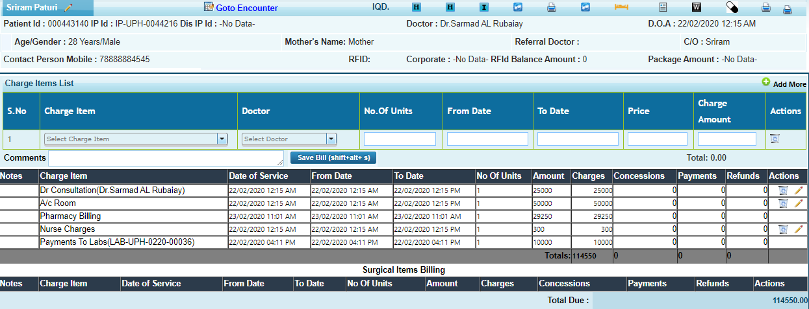
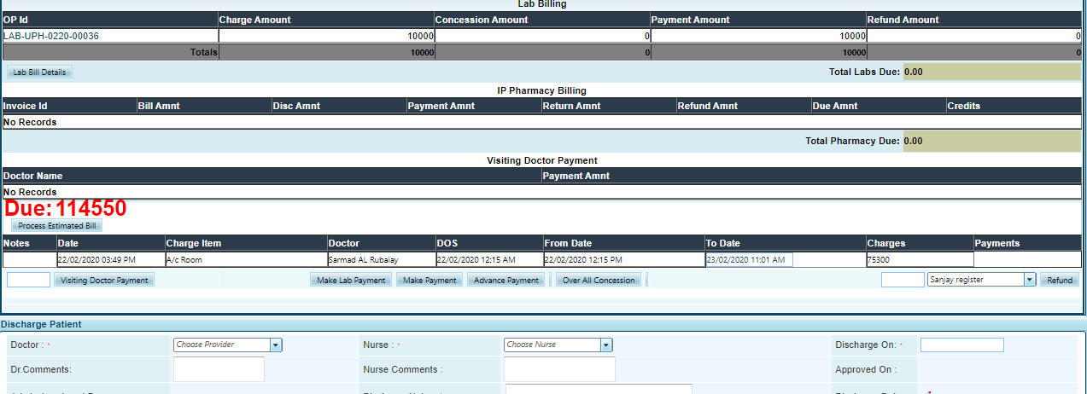
IP-BILLING SCREEN
© HiTech Solutions & Services Pvt. Ltd

Slide 34
EMERGENCY DEPARTMENT
© HiTech Solutions & Services Pvt. Ltd

Slide 35
Emergency Department
Enable emergency registration of patients by capturing key registration details
Facility to capture details about condition of patient during arrival and mode of arrival
Record and view the various activities performed by the nurse (notes, vitals, drugs etc.)
Move patient from emergency to ward
Facility to manage user
Special nursing station for emergency department
© HiTech Solutions & Services Pvt. Ltd

Slide 36
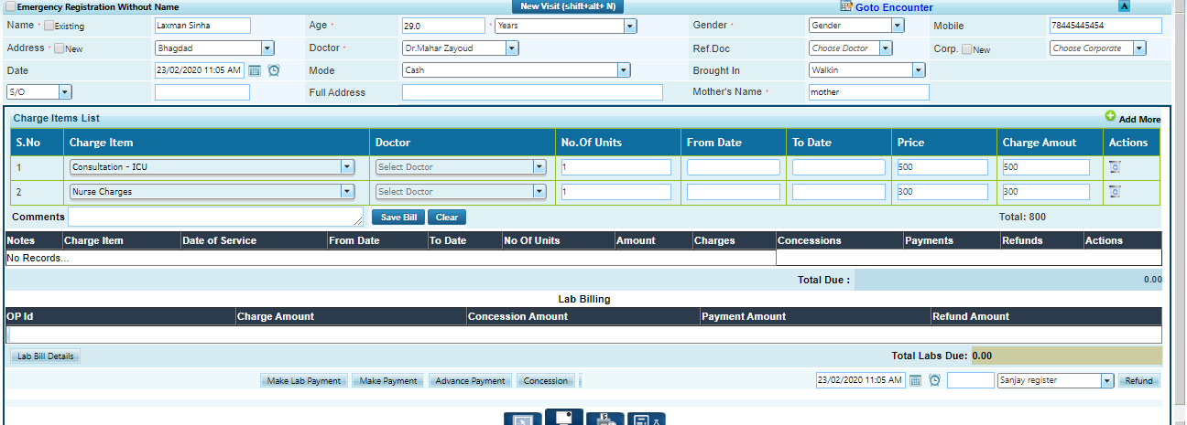
Emergency Management
© HiTech Solutions & Services Pvt. Ltd

Slide 37
LAB / RADIOLODY BILLING
© HiTech Solutions & Services Pvt. Ltd

Slide 38
Lab/ Radiology Billing
All lab and radiology test with prices
Refund , discount , free bill making facility
RFID Card system
IP Patient , OP Patient and Casualty Patient lab bill creation
Patient color status code
Cashier billing history
© HiTech Solutions & Services Pvt. Ltd

Slide 39
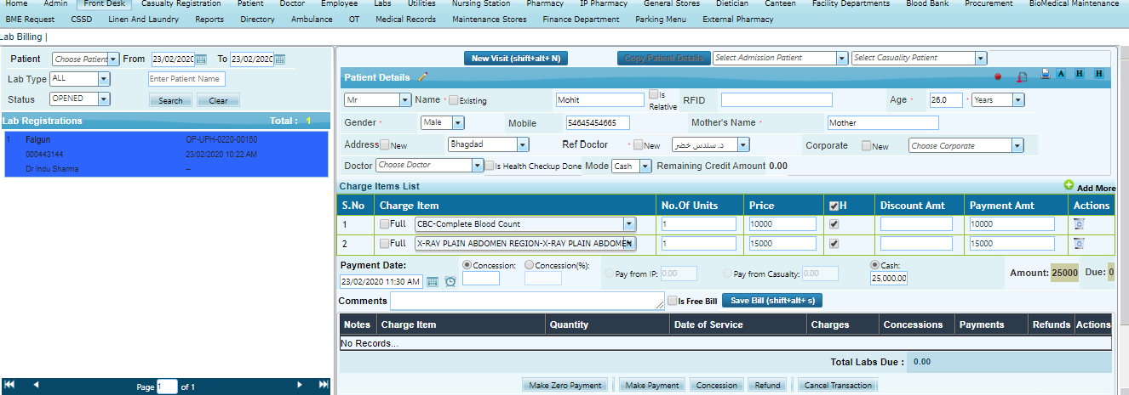
Lab / Radiology Billing
© HiTech Solutions & Services Pvt. Ltd

Slide 40
DOCTOR MODULE
© HiTech Solutions & Services Pvt. Ltd

Slide 41
Doctor Module
List of appointments booked for the current day or any future day
List of outpatients most recently seen by the physician
List of inpatients admitted in the hospital under the care of the physician
List of pending surgeries scheduled for the physician
Patient history as a drill down from each of the above list
Drill down to reports/charts for each episode
Favorite drug list
Patient cross reference and ICD code
Results of ordered laboratory/radiology tests
Physician recordings under the four broad heads - SOAP (Subjective, Objective, Assessment and Plan) as followed by most physicians all over the world
© HiTech Solutions & Services Pvt. Ltd

Slide 42
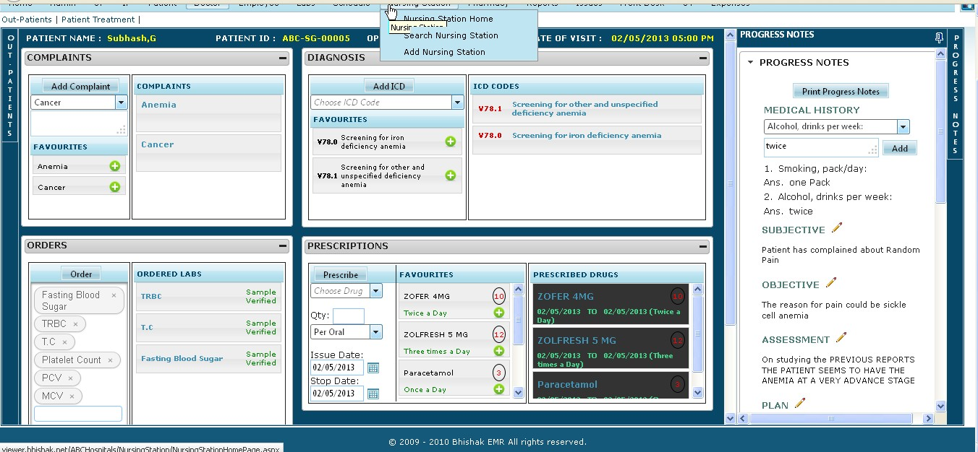
Doctor Module
© HiTech Solutions & Services Pvt. Ltd

Slide 43
LAB management
© HiTech Solutions & Services Pvt. Ltd

Slide 44
Lab Information System
Provision to set reference range for each tests
Delta values and trend analysis
Alerts for abnormal results
Sample Result Entry
Bulk Sample Request
Sample Details
Samples Received from External Laboratory
Samples Dispatch to External Reference Laboratory
Investigation and Treatment History
Test Report can be made confidential. Test can be performed only after billing is done
© HiTech Solutions & Services Pvt. Ltd

Slide 45
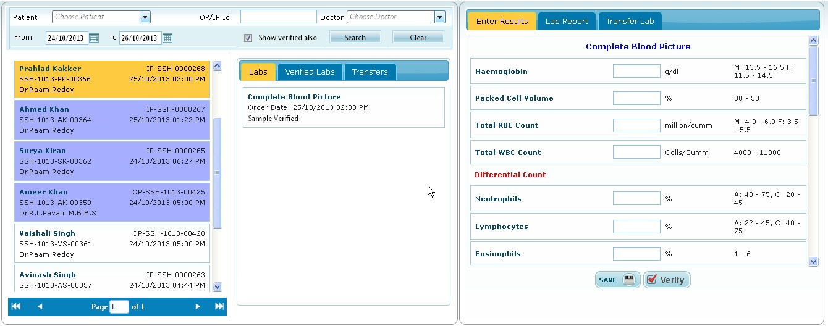
Lab Information System
© HiTech Solutions & Services Pvt. Ltd

Slide 46
Radiology Management
© HiTech Solutions & Services Pvt. Ltd

Slide 47
Radiology Management
The radiology module covers the processes starting from the booking of appointments of the modalities against the investigation requests raised by doctor to delivering the results to the ordering doctor of the hospital. HIMS radiology module is completely compatible with the imaging technologies used by radiologists and offers Smart methodologies for the radiologists to interpret and infer results reducing their time consumption and effort.
Salient features :Efficient utilization of resources- Duty roster for radiologist and equipment
Statistical reports provided like:
Investigation details
Tests/Investigations performed by each technician/radiologist for selected date range
Doctor wise tests/investigations prescribed
Details of tests completed, aborted, cancelled, or Pending
Customizable result templates
Results entry made simpler with efficient RTF format Reports
Easy retrieval of patient data at any phase of a radiology request
© HiTech Solutions & Services Pvt. Ltd

Slide 48
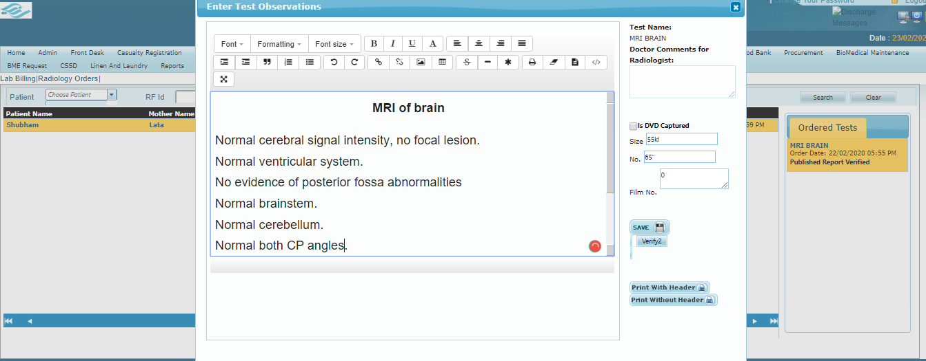
Radiology Management
© HiTech Solutions & Services Pvt. Ltd

Slide 49
PACS-
PICTURE ARCHIVING AND
COMMUNICATION SYSTEM
© HiTech Solutions & Services Pvt. Ltd

Slide 50
PACS
Replace the need for hard-copy films and management of physical archives
Allow for remote access , enabling clinicians in different location to review
Easy to examine the patient case in detail
Any time the patient images are available in the archive and it is retrieved by just a touch of a button from when the patient revisits the hospital
PACS integration with HL7 interface, adherence to ICD-10 coding and DICOM imaging standards
© HiTech Solutions & Services Pvt. Ltd

Slide 51
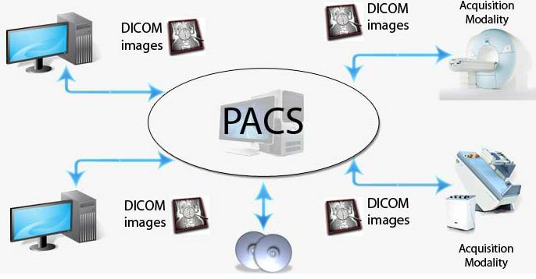
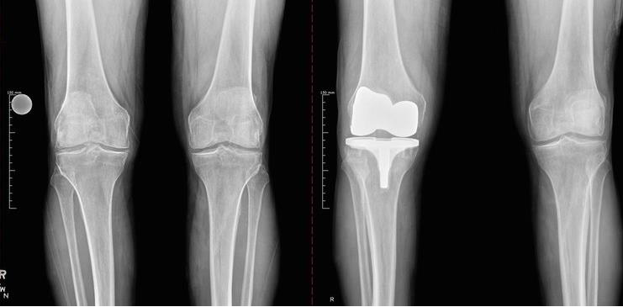
PACS
© HiTech Solutions & Services Pvt. Ltd

Slide 52
WARD MANAGEMENT
© HiTech Solutions & Services Pvt. Ltd

Slide 53
Ward Management
View occupied and available bed
Room Number
Floor Management
Facility register patient without bed also
Occupied Bed patient search facility available
Room Transfer available
© HiTech Solutions & Services Pvt. Ltd
© HiTech Solutions & Services Pvt. Ltd

Slide 54
Ward Management
© HiTech Solutions & Services Pvt. Ltd

Slide 55
NURSING STATION MODULE
© HiTech Solutions & Services Pvt. Ltd

Slide 56
Nursing Station
Patient Charting :A patient’s vital signs, admission and nursing assessments and nursing notes can be entered into the system. These are the stored in a central repository and retrieved when needed.
Clinical Data Integration :Here clinical information from all the disciplines can be retrieved, viewed and analyzed by nursing staff.
Better care planning :Time spent on care planning is reduced, while the quality of what is recorded is improved. This makes for more complete care plans and more complete assessments and evaluations.
Drug administration :Electronically prescribed drugs are more legible, thus making it less likely that drugs would be wrongly administered to patients.
Digital Sheets : Follow up , consultation sheet, Doctor tour sheet, Doctor treatment details, Patient Medication, Follow-up sheet, Mode ventilator
© HiTech Solutions & Services Pvt. Ltd

Slide 57
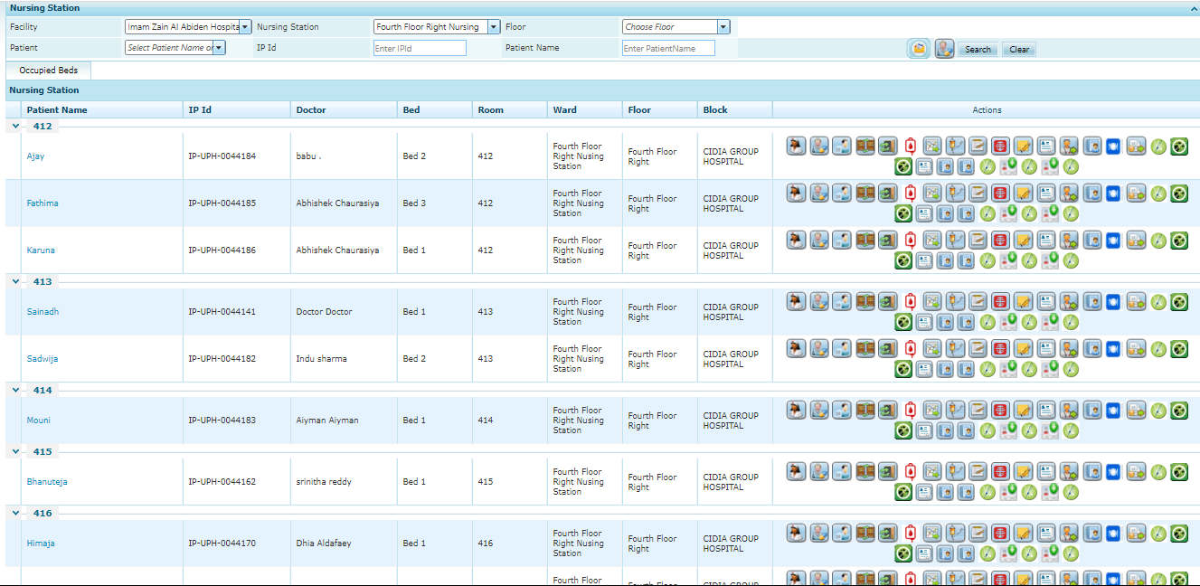
Nursing Station
© HiTech Solutions & Services Pvt. Ltd

Slide 58
Pharmacy Management
© HiTech Solutions & Services Pvt. Ltd
© HiTech Solutions & Services Pvt. Ltd

Slide 59
Pharmacy
The Pharmacy Module caters to the retail Out Patient pharmacy, General Outpatient pharmacy, the ward and Inpatient Pharmacies.
Salient Features : Drug definition based on Generic name, Brand Name, form Name and Drug strength
Multi Units of Measurement and multi-currency
Stock Control
Drug association to suppliers
Multiple Units within Facility (IP, OP, OT, Nursing Station)
Dosage calculation
Drug tracking report and Drug expiry report
Enquiry generation
Quotations based on enquiry
Purchase order generation
Goods receipt (GRN)
Drug Expiry control
Inventory Management
© HiTech Solutions & Services Pvt. Ltd

Slide 60
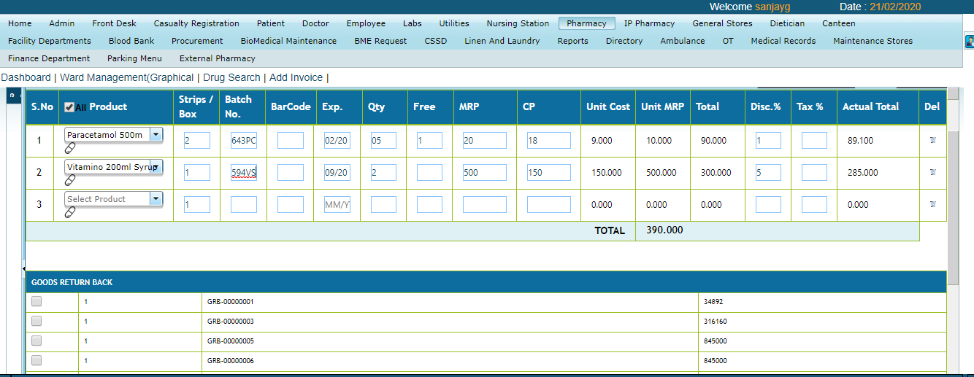
Pharmacy Sales Invoice
© HiTech Solutions & Services Pvt. Ltd

Slide 61
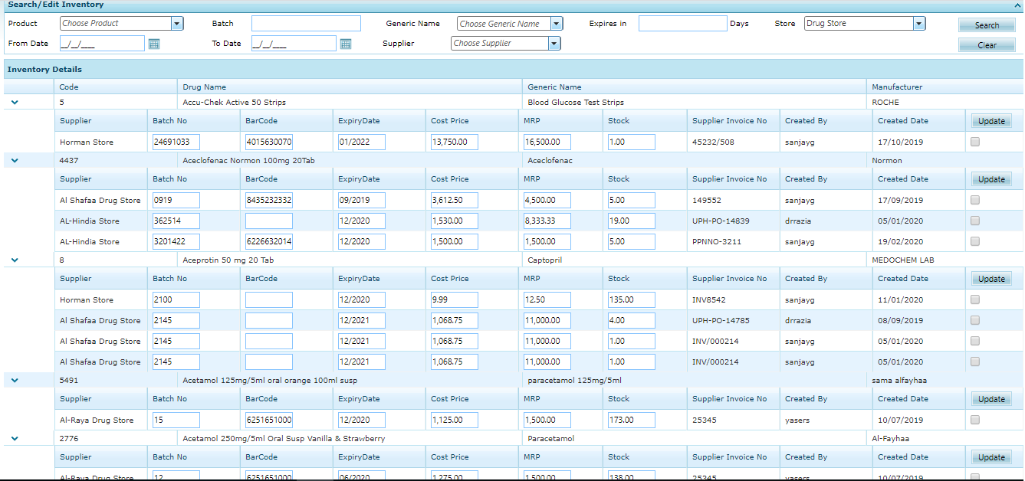
Pharmacy – Edit Inventory
© HiTech Solutions & Services Pvt. Ltd

Slide 62
OpERATION THEATRE MODULE
© HiTech Solutions & Services Pvt. Ltd

Slide 63
Operation Theatre
According to specialty operation name will appear with prices
Date range facility
Nurse specialty available
Anesthesia details
Type of operation
Operation schedule facility
Operation Nursing Station
Operation store inventory management
Operation detailed report
© HiTech Solutions & Services Pvt. Ltd

Slide 64
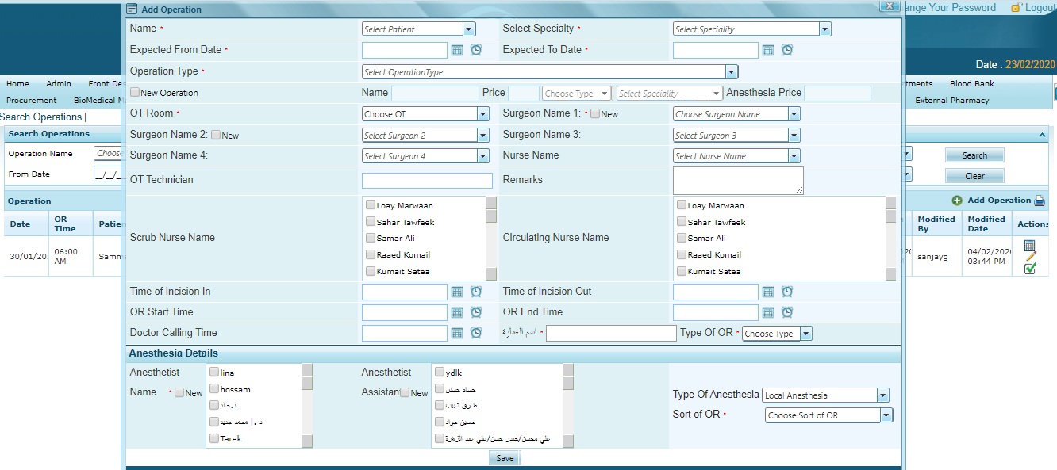
OT- Module
© HiTech Solutions & Services Pvt. Ltd

Slide 65
BLOOD BANK MANAGEMANT
© HiTech Solutions & Services Pvt. Ltd

Slide 66
Blood Bank Management
Main functions of Blood Bank module of Hospital Management Software
Registration of Donors
Blood Donation
Need based request processing (Fresh Blood and Stored Blood)/cancellation
Returning of issued blood bags
Transfusion Details
Sterility Investigations and Discard Details
Inter Bank Transactions
Blood camp organizing management
Request receive facility from nursing station
© HiTech Solutions & Services Pvt. Ltd

Slide 67
Blood Bank Management
© HiTech Solutions & Services Pvt. Ltd

Slide 68
CANTEEN DEPARTMENT
© HiTech Solutions & Services Pvt. Ltd

Slide 69
Canteen
Invoice making facility
Inventory management
Pictorial screen
Product mapping
Floor wise canteen management
Floor wise product management
Easy to use on touch screen monitors or devices
Stock alert system
© HiTech Solutions & Services Pvt. Ltd

Slide 70
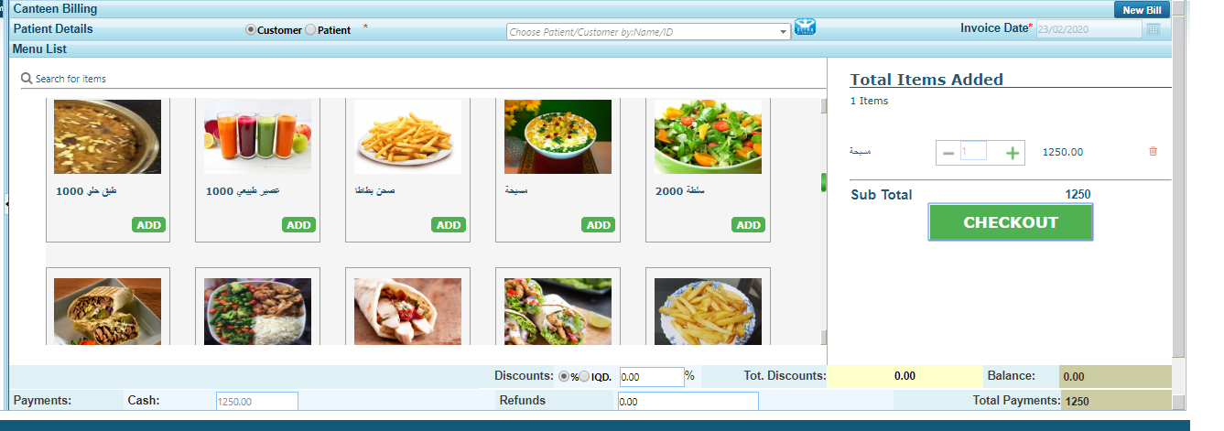
Canteen
© HiTech Solutions & Services Pvt. Ltd

Slide 71
MIS reports
© HiTech Solutions & Services Pvt. Ltd

Slide 72
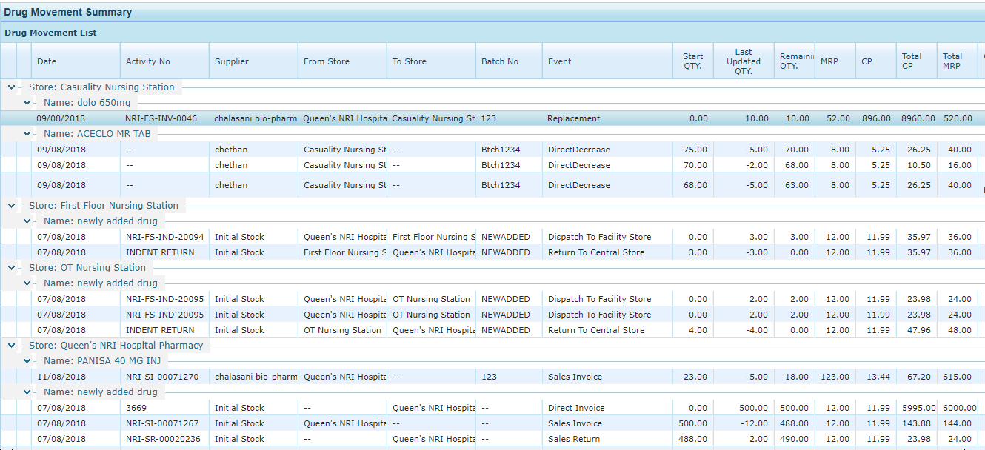
Drug Tracking Report
© HiTech Solutions & Services Pvt. Ltd

Slide 73
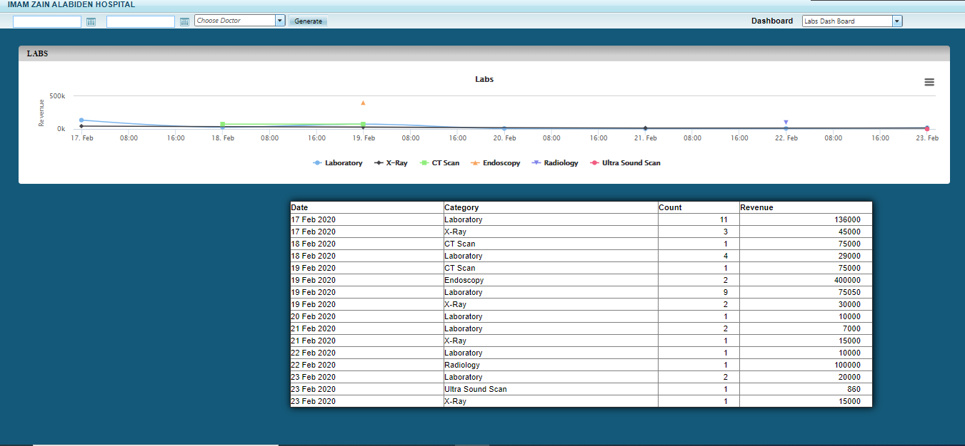
MIS Dashboard
© HiTech Solutions & Services Pvt. Ltd

Slide 74
IP Census Report
© HiTech Solutions & Services Pvt. Ltd

Slide 75
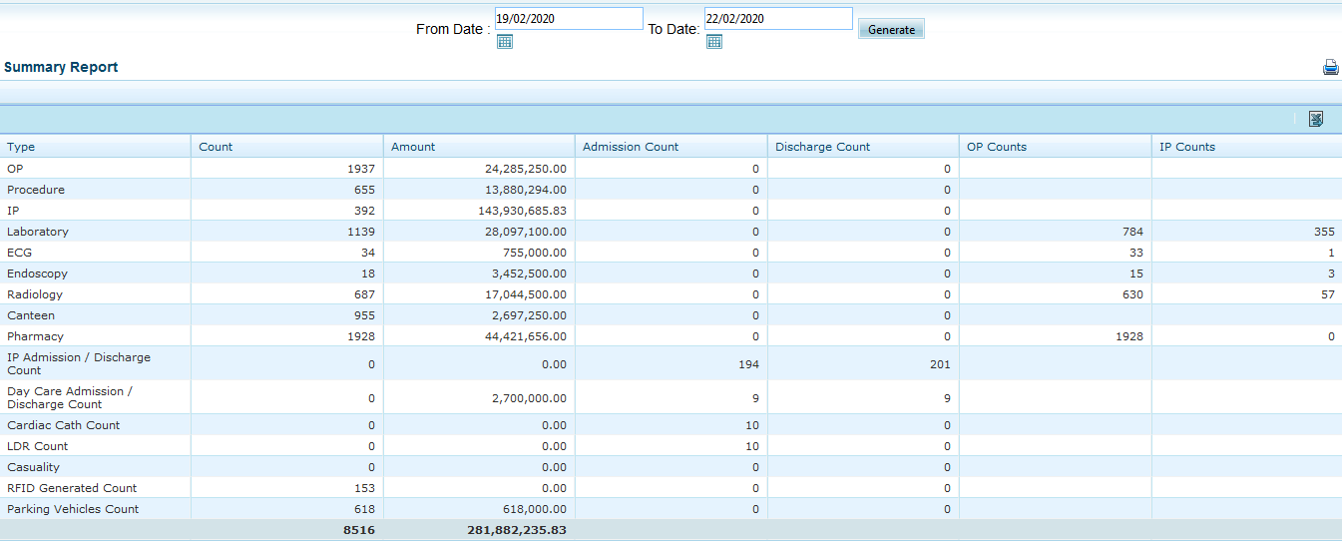
Daily Activity Report
© HiTech Solutions & Services Pvt. Ltd

Slide 76
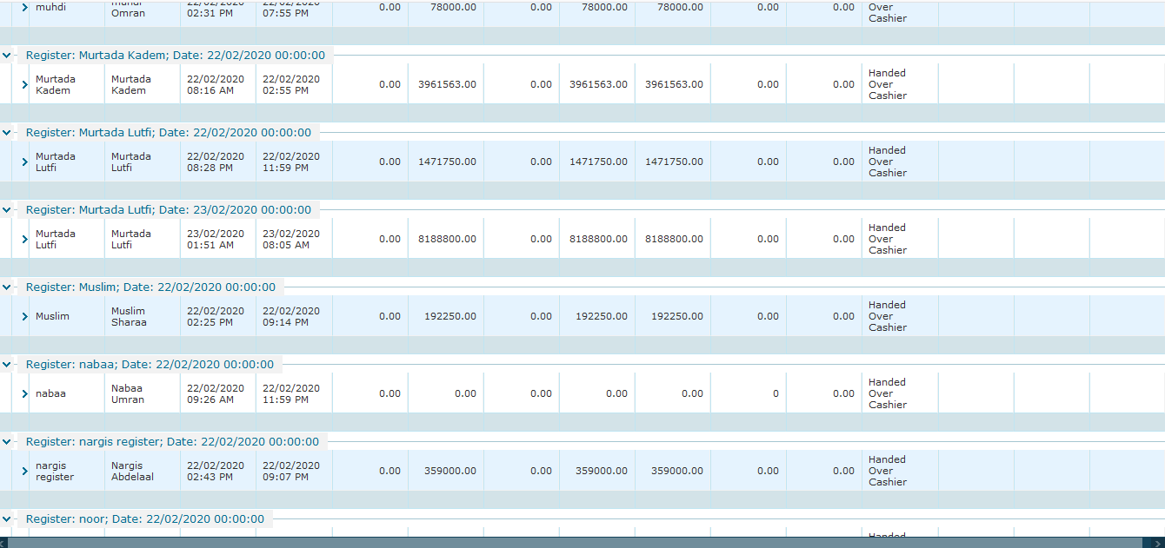
User Cash Collection Report
© HiTech Solutions & Services Pvt. Ltd

Slide 77
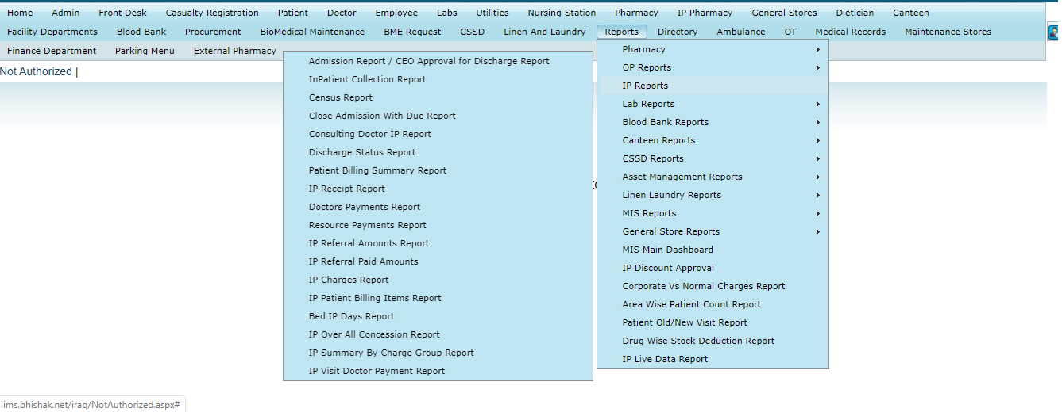
Many More Reports
© HiTech Solutions & Services Pvt. Ltd

Slide 78
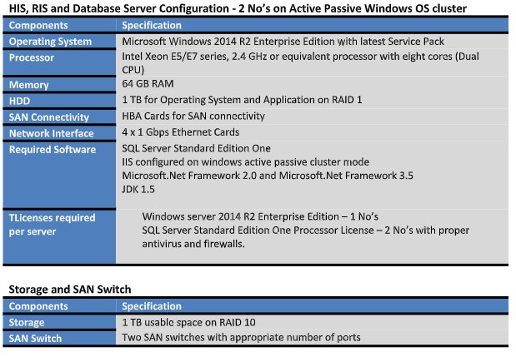
Hardware Specification
© HiTech Solutions & Services Pvt. Ltd

Slide 79
Support
Phone, Email and Chat Support
Live Support (Online Support through Chat)
Remote Access Support
Onsite Support
Onsite Implementation
Onsite and Online Training
Client Specific Requirement Analysis
Client Specific Customization
Localized Support
OUR
SUPPORT
© HiTech Solutions & Services Pvt. Ltd

Slide 80
Contact Us
Corporate Office : 4th Floor, Divine Complex, Kalimati
Kathmandu, Nepal
Tel : 00977-1- 4289641 / 4289642 / 4289643
Branch Offices:
Narayangarh, Pokhara, Butwal, Birgunj, Nepalgunj, Banepa, Janakpur, Biratnager, Bhairahwa, Lahan, Mahendranagar, Dharan and Dhangadi
Websites : www.hitechnepal.com.np
© HiTech Solutions & Services Pvt. Ltd

Slide 81
© HiTech Solutions & Services Pvt. Ltd

